Slide 1
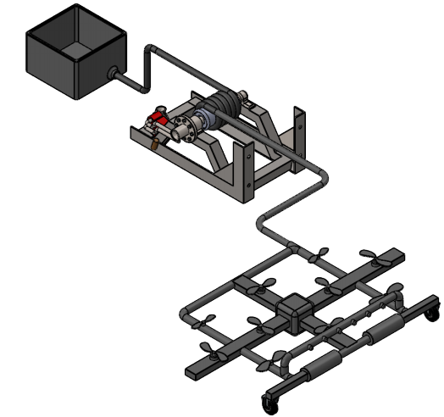
Traffic Sign Cleaning
DEFINING NEW WAYS
Abdalla
Saad
Abdulrahman
Mohammed
Mosaad
Abdullah

Slide 2
OVERVIEW
Project Description
Requirements
Design Solution
Design Making
System Manufacturing and Assembly
Design Of Manufacturing and Assembly (DFMA)
Testing
Budget
Future Work
References
Appendix

Slide 3
PROJECT DESCRIPTION
Traffic Signs play an important role in controlling the traffic
Traffic Signs always uses sharp color, see from the long distance
Traffic Sign Board on the highways need to clean
Drivers need to see the instructions clearly
Traffic flow on highways cannot disrupt
Design a system that can clean traffic sign boards
Without Disturbing the traffic flow
Client
Dr. Hesam Moghaddam

Slide 4
CUSTOMER REQUIREMENTS
Customer Requirements | Weightage
Do not interrupt the flow of traffic | 9
Failsafe | 8
Collect Water Drops | 7
Clean in short time | 6
Clean without damaging the coating | 5
Safe to Operate | 4
Cost within budget | 3
Durable and Robust Design | 2
Reliable Design | 1

Slide 5
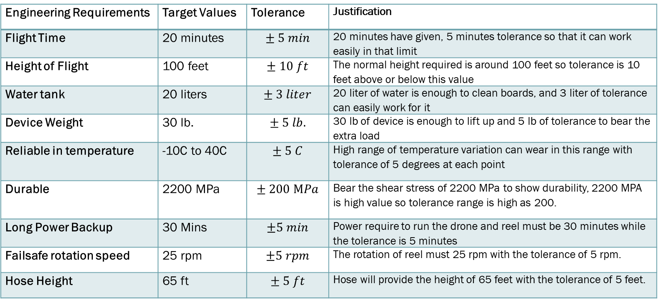
ENGINEERING REQUIREMENTS
Engineering Requirements | Target Values | Tolerance | Justification
Flight Time | 20 minutes | $$± 5 min$$ | 20 minutes have given, 5 minutes tolerance so that it can work easily in that limit
Height of Flight | 100 feet | $$± 10 ft$$ | The normal height required is around 100 feet so tolerance is 10 feet above or below this value
Water tank | 20 liters | $$± 3 liter$$ | 20 liter of water is enough to clean boards, and 3 liter of tolerance can easily work for it
Device Weight | 30 lb. | $$± 5 lb.$$ | 30 lb of device is enough to lift up and 5 lb of tolerance to bear the extra load
Reliable in temperature | -10C to 40C | $$± 5 C$$ | High range of temperature variation can wear in this range with tolerance of 5 degrees at each point
Durable | 2200 MPa | $$± 200 MPa$$ | Bear the shear stress of 2200 MPa to show durability, 2200 MPA is high value so tolerance range is high as 200.
Long Power Backup | 30 Mins | $$±5 min$$ | Power require to run the drone and reel must be 30 minutes while the tolerance is 5 minutes
Failsafe rotation speed | 25 rpm | $$±5 rpm$$ | The rotation of reel must 25 rpm with the tolerance of 5 rpm.
Hose Height | 65 ft | $$± 5 ft$$ | Hose will provide the height of 65 feet with the tolerance of 5 feet.

Slide 6
DESIGN SOLUTION
The design decided to use drone
10 propellers are using on the drone to fly in the air
Pipe Structure is using to build the drone
Nozzle are using on the design to shower water on sign boards
Soft brush rollers are using to wipe the boards
Water is supplying to the drone from ground tank
Hose is connecting with the drone to provide fail-safe

Slide 7

DESIGN SOLUTION
Final Design CAD Model

Slide 8
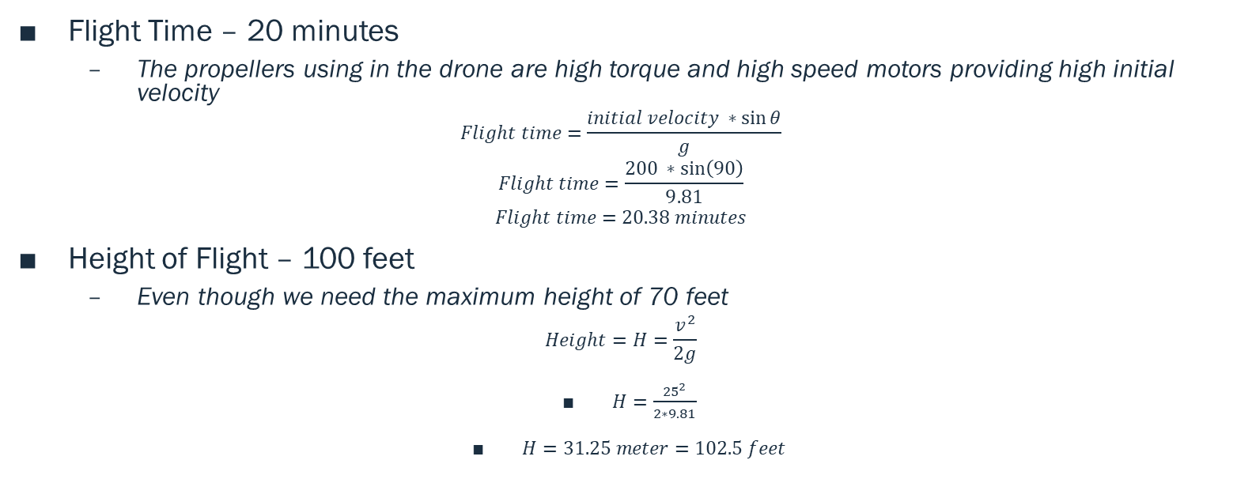
DESIGN MAKING
Flight Time – 20 minutes
The propellers using in the drone are high torque and high speed motors providing high initial velocity
$$Flight time=\frac{initial velocity ∗\sin{θ}}{g}$$
$$Flight time=\frac{200 ∗\sin\left(90\right)}{9.81}$$
$$Flight time=20.38 minutes$$
Height of Flight – 100 feet
Even though we need the maximum height of 70 feet
$$Height=H=\frac{v^{2}}{2g}$$
$H=\frac{{25}^{2}}{2∗9.81}$
$H=31.25 meter=102.5 feet$

Slide 9
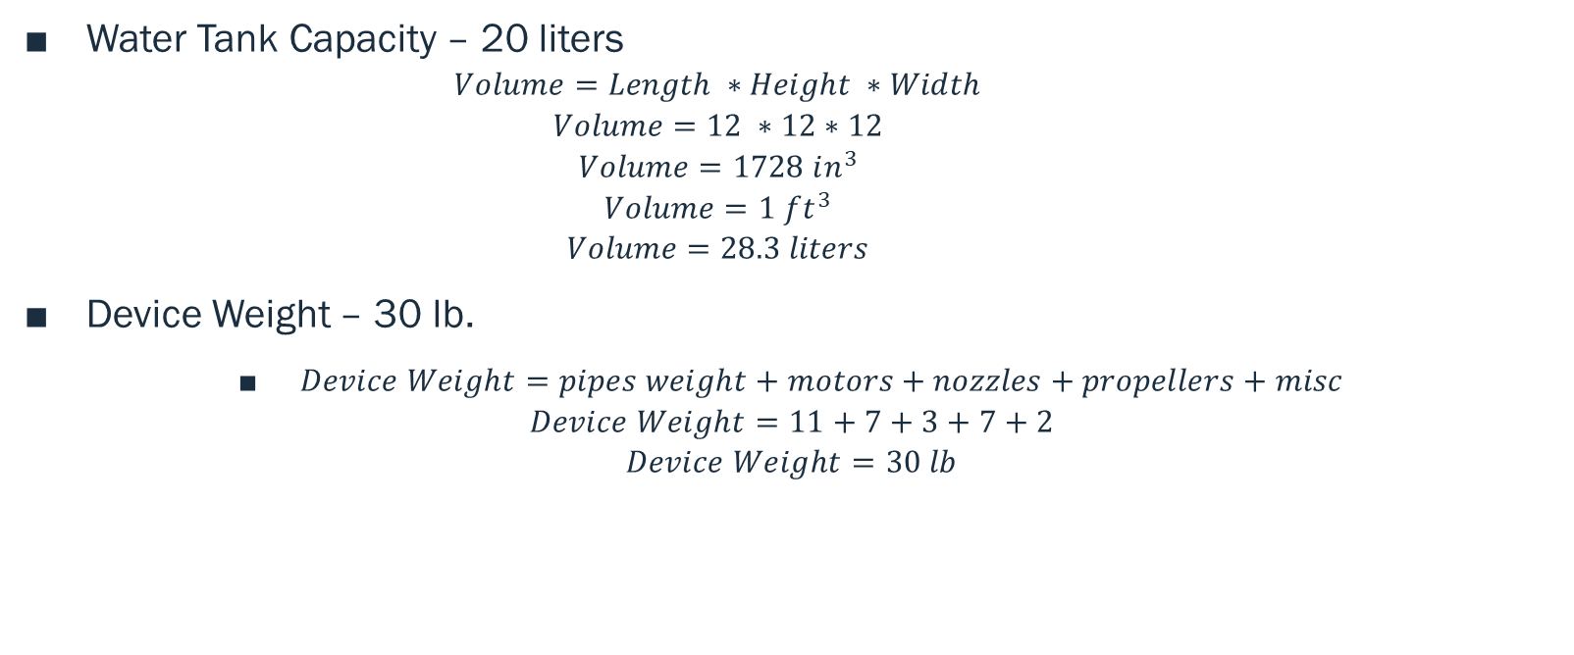
DESIGN MAKING
Water Tank Capacity – 20 liters
$$Volume=Length ∗Height ∗Width$$
$$Volume=12 ∗12∗12$$
$$Volume=1728 in^{3}$$
$$Volume=1 ft^{3}$$
$$Volume=28.3 liters$$
Device Weight – 30 lb.
$Device Weight=pipes weight+motors+nozzles+propellers+misc$
$$Device Weight=11+7+3+7+2$$
$$Device Weight=30 lb$$

Slide 10
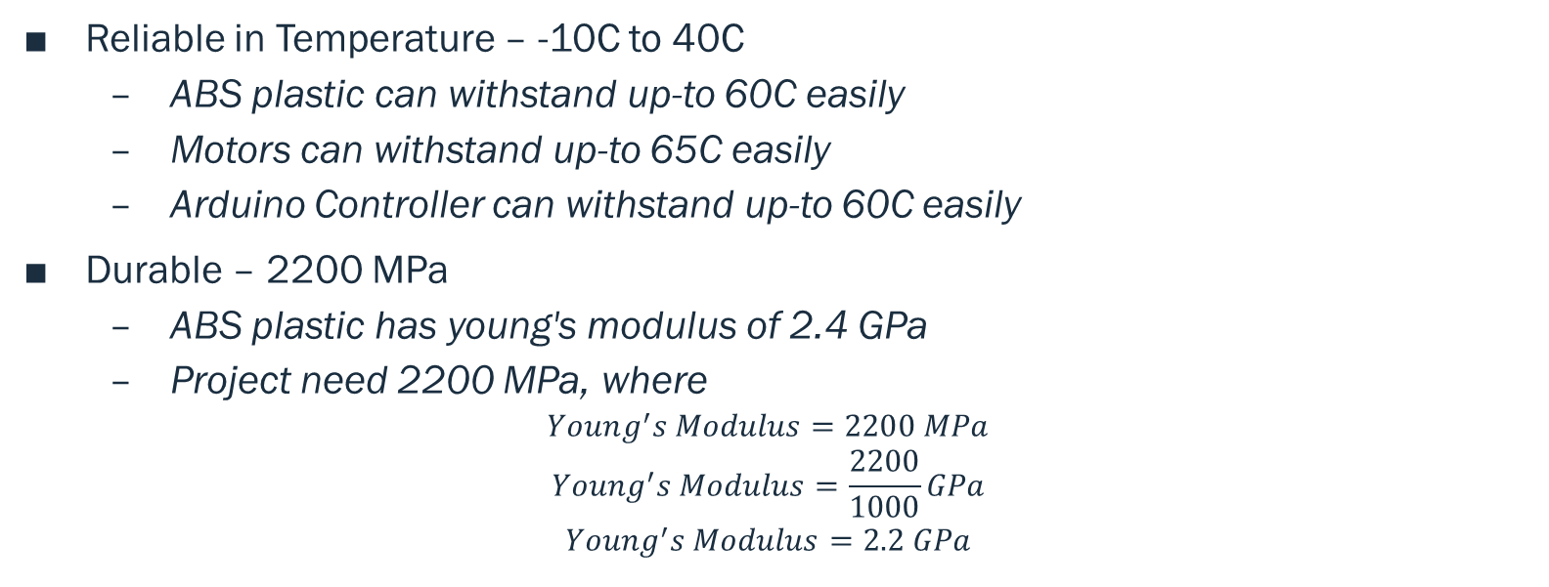
DESIGN MAKING
Reliable in Temperature – -10C to 40C
ABS plastic can withstand up-to 60C easily
Motors can withstand up-to 65C easily
Arduino Controller can withstand up-to 60C easily
Durable – 2200 MPa
ABS plastic has young's modulus of 2.4 GPa
Project need 2200 MPa, where
$$Young^{′}s Modulus=2200 MPa$$
$$Young^{′}s Modulus=\frac{2200}{1000}GPa$$
$$Young^{′}s Modulus=2.2 GPa$$

Slide 11
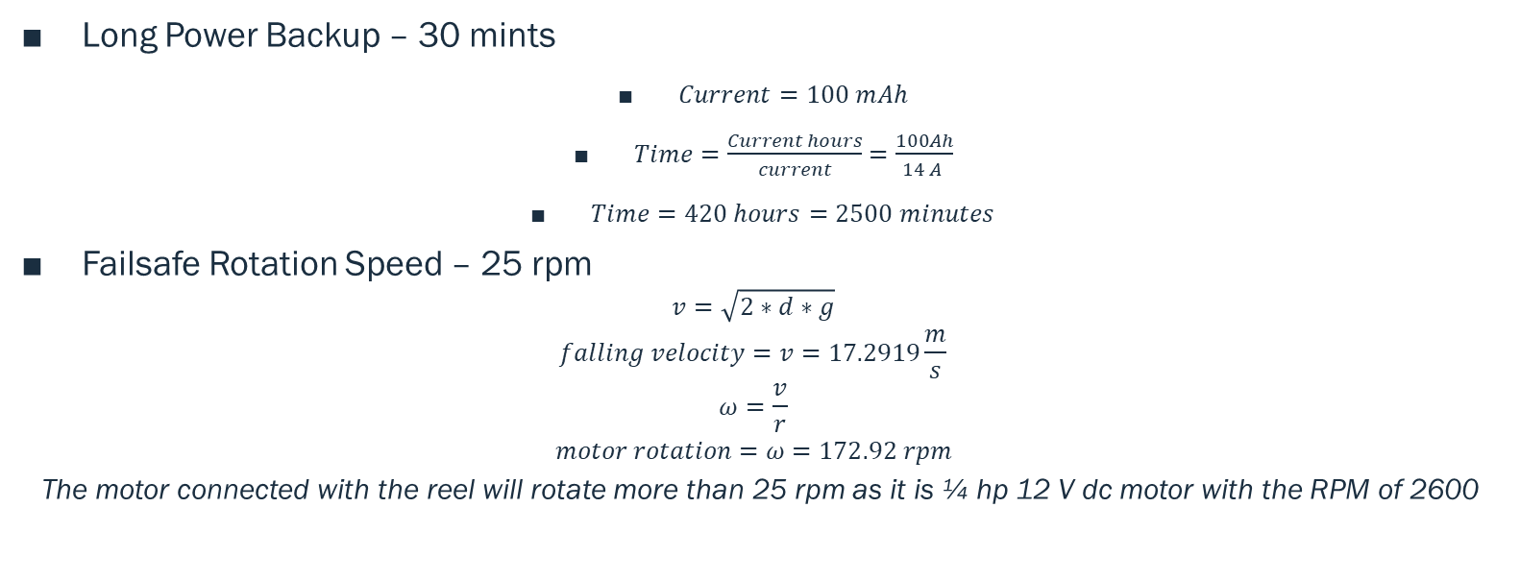
DESIGN MAKING
Long Power Backup – 30 mints
$Current=100 mAh$
$Time=\frac{Current hours}{current}=\frac{100Ah}{14 A }$
$Time=420 hours=2500 minutes$
Failsafe Rotation Speed – 25 rpm
$$v=\sqrt{2∗d∗g}$$
$$falling velocity=v=17.2919\frac{m}{s}$$
$$ω=\frac{v}{r}$$
$$motor rotation=ω=172.92 rpm$$
The motor connected with the reel will rotate more than 25 rpm as it is ¼ hp 12 V dc motor with the RPM of 2600

Slide 12
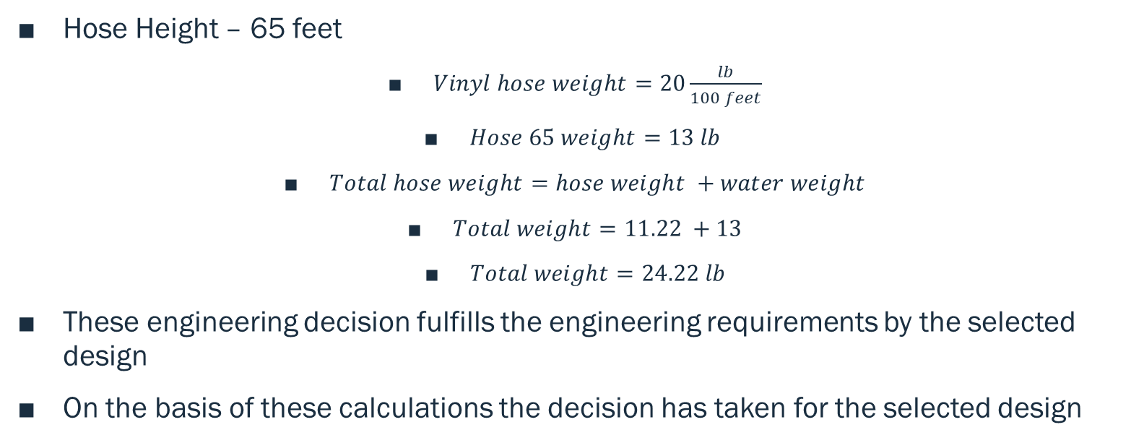
DESIGN MAKING
Hose Height – 65 feet
$Vinyl hose weight=20\frac{lb}{100 feet}$
$Hose 65 weight=13 lb$
$Total hose weight=hose weight +water weight$
$Total weight=11.22 +13$
$Total weight=24.22 lb$
These engineering decision fulfills the engineering requirements by the selected design
On the basis of these calculations the decision has taken for the selected design

Slide 13
BACKUP DESIGN DECISION
For Backup design, remove the hose, water tank
Connect the battery with the drone
Place the bottle holder
Fly the drone with the same propellers and same motors

Slide 14
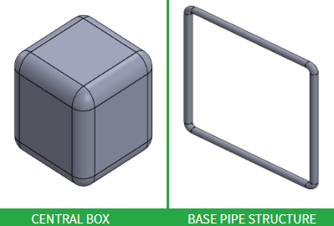
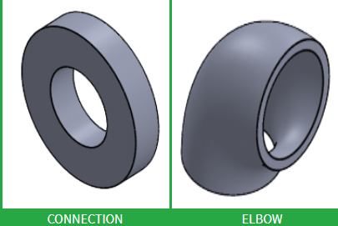
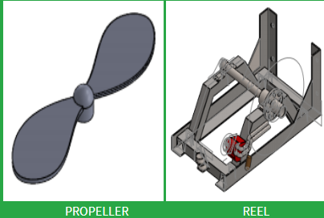
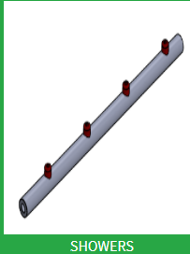
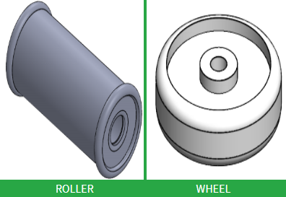
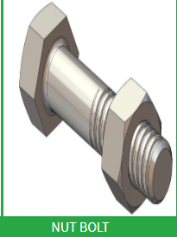
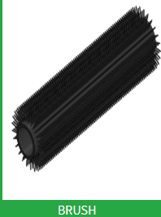
SYSTEM MANUFACTURING
COMPONENTS DETAILS

Slide 15
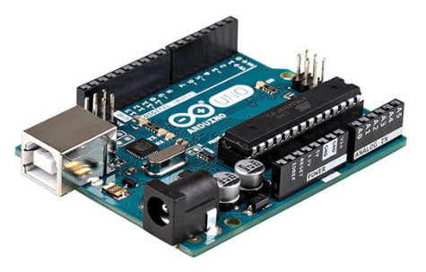
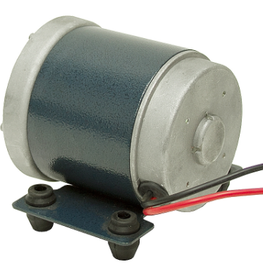
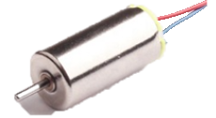
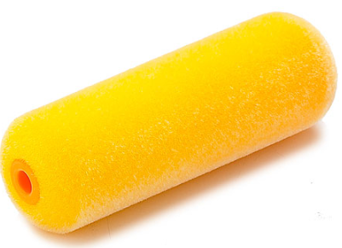
SYSTEM MANUFACTURING
Components Details
Arduino UNO R3
Propeller Motor
Soft Fabric Brush
Reel Engine

Slide 16
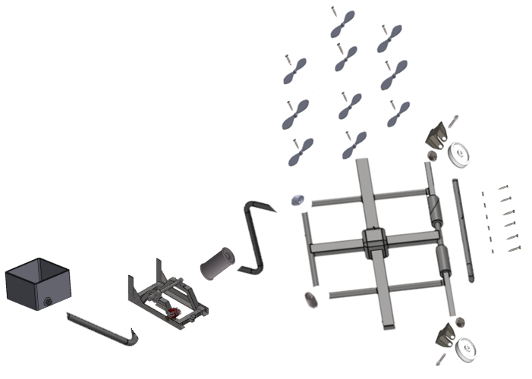
SYSTEM ASSEMBLY
Assembly Time for Drone is 1200 seconds
Number of parts are 56
20 Screws
2 Nut Bolts
6 Elbows

Slide 17
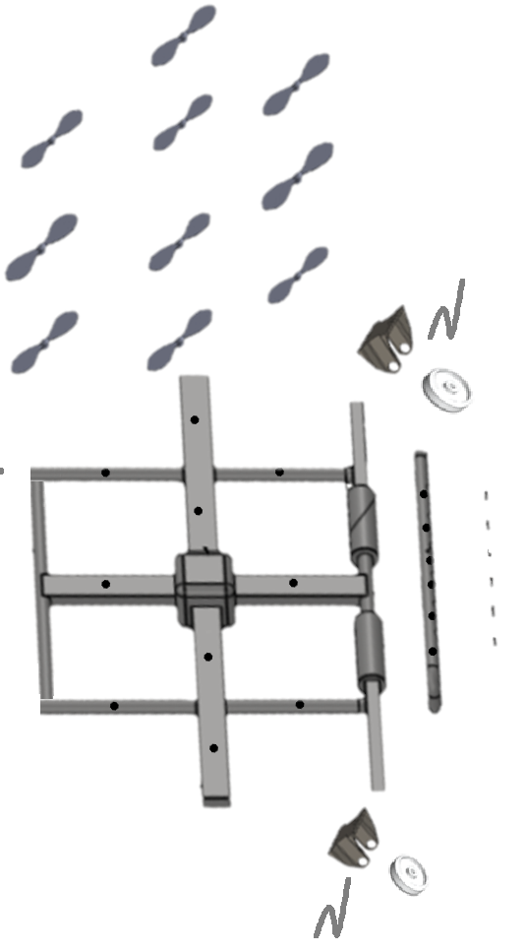
DESIGN OF ASSEMBLY (DFA)
ORIGINAL DESIGN
RE-DESIGN
Assembly Time for Drone is1200 seconds
Number of parts are 56
20 Screws
2 Nut Bolts
6 Elbows
Assembly Time drop to 300 seconds
Number of parts reduced to 32
0 Screws
2 Hooks
2 Elbows

Slide 18
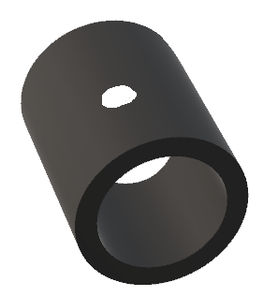
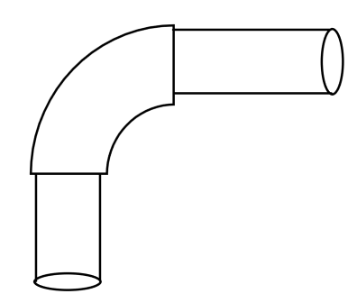
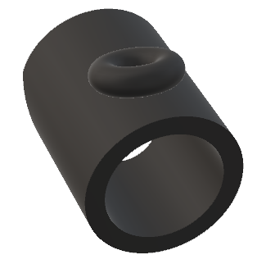
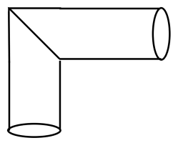
DESIGN OF MANUFACTURING (DFM)
Pipe Connect Propeller Original
Re-design for pipe
Pipe Joint Original
Pipe Joint Re-Design

Slide 19
DESIGN OF MANUFACTURING AND ASSEMBLY (DFMA)
Description | Original Design | Redesign | Improvements %
Assembly Time Hours | 1.5 | 0.3 | 80
No. of Different Parts | 26 | 4 | 84.62
Total No. of Parts | 56 | 32 | 42.8
Cost | $902 | 780 | 13.5%
Labor Cost | $200 | $165 | 17.5%

Slide 20
FMEA
Part # and Functions | Potential Failure Mode | Potential Effect(s) of Failure | Severity (S) | Potential Causes and Mechanisms of Failure | Occurrence (O) | Current Design Controls Test | Detection (D) | RPN | Recommended Action
1 Controller
1.1 Controller Brun | Burning of Controller | Disconnection with Drone | 7 | 1. Bad quality of controller | 4 | 1. Over Voltage Test | 4 | 112 | Check the quality of controller
2 Motor
2.1 Shaft | Bending of Shaft, Breakage of Shaft | wait for new shaft, cost increased | 7 | 1.Bad quality due to molding, 2. poor quality shaft is used | 4 | 1.Bad seeding, Poor Quality aluminum | 6 | 168 | Test various qualities if pipes available at same cost
3 Arduino |  |  |  |  |  |  |  | 0
3.1 Arduino Board | Burning of board | shorting of circuit | 5 | 1. unsecure circuit lining | 7 | 1. Over Voltage Test | 5 | 175 | Check the circuit lining
4 Power Adopter |  |  |  |  |  |  |  | 0
4.1 Over voltage | Producing over voltage causing other devices to burns | Over Current | 5 | Bad quality of wiring | 5 | 1. Over Voltage Test | 6 | 150 | Check quality of wire copper

Slide 21
TESTING PROCEDURES
Flight Time – 20 minutes
Need the timer to test this ER and see if it has fulfilled
Timer is available in the mobile
Height of Flight – 100 feet
Barometer and GPS device will use to determine the height of drone
Barometer is available in the mechanical lab, GPS is present in the Arduino
Water Tank Capacity – 20 liters
Use the water bottle of 20 liters and fill the tank to see if water tank can store 20 liters or not

Slide 22
TESTING PROCEDURE
Device Weight – 30 lb.
Weight machine need to measure the weight of device
Drone will place over the machine to test
Weight machine is available in the mechanical lab
Reliable in Temperature – -10C to 40C
Put the device in the controlled temperature room
Test it in both highest temperature and lowest temperatures
Available in the chemistry lab

Slide 23
TESTING PROCEDURE
Durable – 2200 MPa
Put the structure under stress by applying the external force
The equipment need to do is stress applying machine and test the structure
The equipment is available in the mechanical lab
Long Power Backup – 30 mints
To test it, timer watch need to see if it consistently get the power for 30 minutes
Timer is available in the mobile

Slide 24
TESTING PROCEDURE
Failsafe Rotation Speed – 25 rpm
The RPM of motor can test by through tachometer.
Tachometer can available in the mechanical lab
Hose Height – 65 feet
Hose height can test through the meter scale
Meter scale can easily available in the civil lab

Slide 25
BUDGET
Part Name | Qty | Unit Cost | Cost
6 mm Motor | 10 | $25.07 | $250.72
Steel Sheet | 1 | $38.32 | $38.32
Arduino | 1 | $3.49 | $3.49
Controller | 1 | $27.99 | $27.99
Reel Motor | 1 | $78.28 | $78.28
Hose | 1 | $29.50 | $29.50
Screws | 50 | $0.02 | $1.14
Pipe | 8 | $22.31 | $178.50
Electric Power Wire | 1 | $11.96 | $11.96
Jumper Wires | 4 | $1.00 | $4.00
Wheels | 2 | $1.23 | $2.45
Propeller | 10 | $6.06 | $60.55
Brushes | 2 | $6.10 | $12.20
Nozzles | 5 | $4.02 | $20.10
Reel | 1 | $50.00 | $50.00
Glue | 2 | $1.22 | $2.44
Total |  |  | $771.64
Total incl. tax |  |  | $902.82

Slide 26
Budget
Components Price | $902
Manufacturing Cost | $65
Labor Cost | $200
Total Cost | $1167

Slide 27
FUTURE WORK
In future, the improvement need to make in the design
It can carry extra load in the air
Drone will become autonomous
Detect the Sign Boards
Clean them without the use of Remote
Auto-refilling of water from the tank
Nozzle operation will become autonomous

Slide 28
REFERENCES
[1] B. Marian, “Investigation of hydraulic fitting losses”, available [online], https://www.researchgate.net/publication/325338468_Investigation_of_hydraulic_fitting_losses
[2] M. Santosh, “Compartive study for Wiper Control System Using MATLAB”, available [online], https://www.researchgate.net/publication/335524435_Comparative_Study_for_Wiper_Control_Systems_using_MATLAB_Tools
[3] P. Imade, “Design, Production, and Testing”, available [online], https://www.researchgate.net/publication/320244094_Design_Production_and_Testing_of_a_Single_Stage_Centrifugal_Pump
[4] B. Mohammed”, Power Supply Architectures for Drones”, available [online], https://www.researchgate.net/publication/336669179_Power_Supply_Architectures_for_Drones_-_A_Review
[5] L. Leo, “Working Principle of Arduino and its tools”, available [online], https://www.researchgate.net/publication/326316390_WORKING_PRINCIPLE_OF_ARDUINO_AND_USING_IT_AS_A_TOOL_FOR_STUDY_AND_RESEARCH

Slide 29
APPENDIX – BILL OF MATERIALS
Part # | Part Name | Qty | Description | Functions | Material | Dimensions | Cost
1 | 6 mm Motor | 10 | Rotate the Propellers | Rotate the propellers | Steel | 1.2 x 1 in | $250.72
2 | Steel Sheet | 1 | For Water Tank | Make the Water Tank | Steel | 100 x 100 mm | $38.32
3 | Arduino | 1 | Control the Drone | Pass the signals to each part | Silicon | 4 in x 4 in | $3.49
4 | Controller | 1 | Control the Remotely | Connect with Arduino to pass signals | Plastic | 6 x 4 in | $27.99
5 | Reel Motor | 1 | Rotate the reel | Provide Failsafe operation | Iron Copper | 15 in x 8 in | $78.28
6 | Hose | 1 | Connect with Drone and Reel | Provide Failsafe operation | plastic | 4 x 2 in | $29.50
7 | Screws | 50 | Make the connections | Hold the parts | Steel | 0.5 x 0.1 in | $1.14
8 | Pipe | 8 | Make drone structure | Design the Structure | ABS Plastic | 50 feet | $178.50
9 | Electric Power Wire | 1 | Provide Power | Connect the power with the Arduino | Copper | 10 feet | $11.96
10 | Jumper Wires | 4 | Connect between the parts | Make all the connection for supply | Copper | 6 x 0.1 in | $4.00
11 | Wheels | 2 | To move the device | Assist in moving by reducing friction | Rubber | 6 in | $2.45
12 | Propeller | 10 | Rotate the Propellers | Lift the drone with the propeller | Plastic | 4 in x 2 in | $60.55
13 | Brushes | 2 | Clean the boards | Rotate and clean the water from board | Fabric | 4 in x 2 in | $12.20
14 | Nozzles | 5 | Shower the water | Throw water on the boards | Steel | 3 in | $20.10
15 | Reel | 1 | Rotate quickly | Provide Failsafe operation | Steel | 20 in x 15 in | $50.00
16 | Glue | 2 | Make the connections of structure | fix the pipes and elbows | Chemical | 6 in | $2.44
Total |  |  |  |  |  |  | $771.64
Total incl. tax |  |  |  |  |  |  | $902.82

Slide 30
FMEA
Part # and Functions | Potential Failure Mode | Potential Effect(s) of Failure | Severity (S) | Potential Causes and Mechanisms of Failure | Occurrence (O) | Current Design Controls Test | Detection (D) | RPN | Recommended Action
1 Controller
1.1 Controller Brun | Burning of Controller | Disconnection with Drone | 7 | 1. Bad quality of controller | 4 | 1. Over Voltage Test | 4 | 112 | Check the quality of controller
1.2 Controller Transmitter | Burning of transmitter | Disconnection with Drone | 6 | 1. Bad quality of transmitter | 4 | 1. Over Voltage Test | 4 | 96 | Check the quality of controller
1.3 Controller Receiver | Burning of Receiver | Disconnection with Drone | 6 | 1. Bad quality of receiver | 4 | 1. Over Voltage Test | 4 | 96 | Check the quality of controller
1.4 Controller Body | Breaking of Body | Cracks and bends | 4 | 1. Bad quality of controller | 3 | 1. Over Pressure Test | 3 | 36 | Check the quality of controller
1.5 Controller Board | Burning of board because of short circuit | Disconnection with Drone | 3 | 1. Bad quality of controller | 3 | 1. Over Voltage Test | 3 | 27 | Check the quality of controller
1.6 Controller battery | battery Dead | Disconnection with Drone | 4 | 1. Bad quality of battery cells | 4 | 1. Over Voltage Test | 4 | 64 | Check the battery quality
1.7 Controller Button | Button failure | Not working of specific function | 3 | 1. Bad quality of push button | 3 | 1. Over Pressure Test | 4 | 36 | Check the quality of button
1.8 Controller Handle | Handle stick motion failure | Not working the directions | 3 | 1. Bad quality of handle | 3 | 1. Over Pressure Test | 3 | 27 | Check the quality of handle
1.9 Controller Screen | Breaking of screen | No display | 3 | 1. Extra pressure and bad quality | 3 | 1. Over Pressure Test | 2 | 18 | Protect the screen
1.10 Controller Range | Failure of range abruptly | Low battery level | 3 | 1. Voltage excess and low level | 2 | 1. Over Voltage Test | 3 | 18 | Check the quality of battery
2 Motor
2.1 Shaft | Bending of Shaft, Breakage of Shaft | wait for new shaft, cost increased | 7 | 1.Bad quality due to molding, 2. poor quality shaft is used | 4 | 1.Bad seeding, Poor Quality aluminum | 6 | 168 | Test various qualities if pipes available at same cost
2.2 Motor Winding | Winding burn out | Cost increase | 8 | 1. bad quality of copper 2. poor windings 3. over voltage, over speed | 4 | 1. Speed test 2. Over voltage test | 5 | 160 | Check multiple motors and test them roguishly

Slide 31
